Slide 1
JavaScript Arrays

Slide 2
Topics
Introduction to JavaScript
Array Declaration methods
Accessing Elements of an Array
Array Methods
Code Examples
Summary

Slide 3
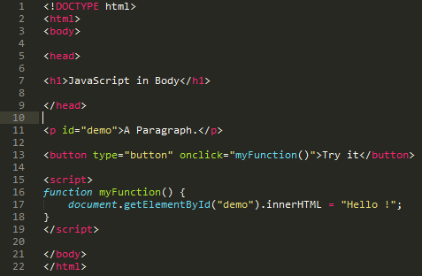
Introduction
Client-side scripting language
Make web pages Interactive
JS code goes between <script> and </script> tags
Scripts can be placed in <body> section and in the <head> section of the HTML page.
Placing scripts at the bottom of the <body> element improves the display speed.
Scripts can be placed in external files.

Slide 4
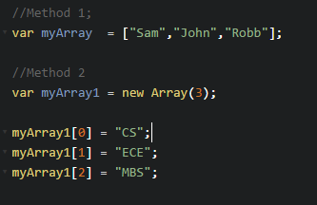
Arrays
An array is a special variable, which can hold more than one value at a time.
Size of an array in JavaScript can be changed (increased) AFTER it is created.
Arrays are not typed. They can contain numbers, strings, boolean, objects, functions, and arrays.

Slide 5
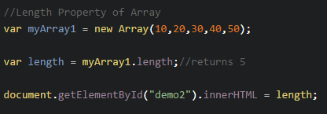
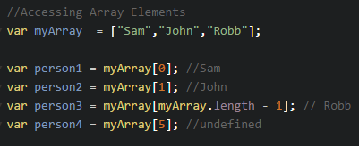
Accessing Array Elements
Full Array can be accessed by the array name.
Individual elements of an Array can be accessed by their index positions
Trying to access array elements beyond the size of an Array will return undefined.
Index positions range from 0 to (length - 1)

Slide 6
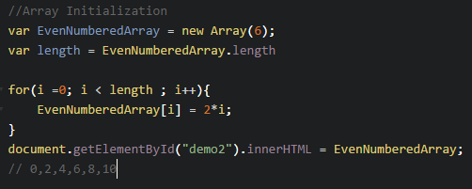
Array Initialization
For loops could be used to iterate over the length of the array and initialize the array elements.
It is a Good programming practice to have fewer statements inside the for loop.

Slide 7
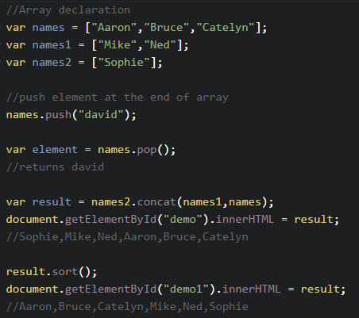
JS Array Methods
push() method adds new item to the end of an Array and also changes the length of the array
pop() method removes the last element from the array and returns that element. It also changes the length of the array.
concat() method creates a new array by concatenating two or more arrays.
sort() method sorts an array alphabetically. By default, the sort() function sorts values as strings.

Slide 8
Summary
JS code should ideally be included at the end of <body> tag.
Array’s can be declared either by using the built-in constructor new Array() or by the use of [ ].
Following is valid array in JS :
var myArray = [“Tim”,1, -5.4, false, [4, 6] , 0 ]
Array’s can dynamically increase in size.
Elements of the array can be accessed by its index position.
Follow the link below to go through the list of examples on Array methods.
https://developer.mozilla.org/en-US/docs/Web/JavaScript/Reference/Global_Objects/Array

